Slide 1
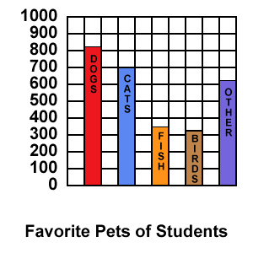
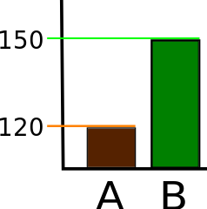
Daily Review
Scientists often show quantitative observations using graphs. For discrete (countable) data, they use column graphs.
Steps for drawing a column graph:
Draw the horizontal and vertical axes.
Label the horizontal axis with the independent variable.
Label the vertical axis with the dependent variable.
Draw each column with a ruler.
Write an appropriate title.
Draw a line across the middle of your whiteboard. In the top half, list the problems with the top graph. In the bottom half, list the problems with the bottom graph.

Slide 2
Scientific Method: Drawing Scatter Graphs Year 7 Science

Slide 3
Learning Objective
CFU 1
What type of graph are we drawing today?
Draw scatter graphs of continuous data.
CFU 2
What is continuous data?
Activate Prior Knowledge
Think, Pair, Share: Look at the graphs on the next slide. Identify as many similarities and differences as you can between the graphs.
Vocabulary
con·tin·u·ous da·ta (noun) data that can be measured

Slide 4
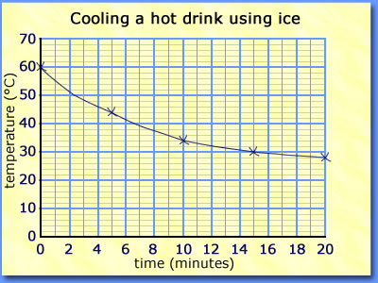
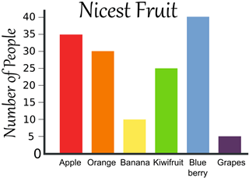
Activate Prior Knowledge
List the similarities and differences between the graphs on your whiteboard.
Favourite Type of Fruit
Number of People
Type of fruit

Slide 5
Concept Development
CFU 1
Which of the following are quantitative observations? The tree was tall The tree was 10.5m tall The plant has pink flowers The plants has 7 flowers
Scientists often show quantitative observations using graphs. For continuous data, they use scatter graphs.
Continuous data is data that must be measured. It can be any number: it doesn’t have to be a whole number like discrete data does.
Examples of continuous data include time, distance and temperature.
CFU 2
In your own words, what is continuous data?
CFU 3
Which of the following is continuous data? Be ready to give a reason why. The plant is 35.7cm tall There are 9 flowers on the plant
Vocabulary
con·tin·u·ous da·ta (noun) data that can be measured

Slide 6
Concept Development
Scientists often show quantitative observations using graphs. For continuous data, they use scatter graphs.
Steps for drawing a scatter graph:
Draw the horizontal and vertical axes.
Label the horizontal axis with the independent variable, including units.
Label the vertical axis with the dependent variable, including units.
Mark each data point with a small dot.
Draw a line of best fit through or near as many dots as possible.
Add a key if there is more than one set of data.
Write an appropriate title.
Vocabulary
con·tin·u·ous da·ta (noun) data that can be measured

Slide 7
Skill Development/Guided Practice
CFU 1
What is the independent variable?
Aim: To find out if plants which are given fertiliser grow faster than plants without fertiliser.
CFU 2
What is the dependent variable?
The data collected in the experiment is shown in the table below.
Time (weeks) | Height of Plant Without Fertiliser (cm) | Height of Plant With Fertiliser (cm)
1 | 6.0 | 6.5
2 | 7.5 | 9.0
3 | 9.5 | 11.5
4 | 11.0 | 14.0
Vocabulary
con·tin·u·ous da·ta (noun) data that can be measured

Slide 8
Skill Development/Guided Practice
Aim: To find out if plants which are given fertiliser grow faster than plants without fertiliser.
Step 1: Draw the horizontal axis two squares from the bottom and the vertical axis two squares from the left edge.
Time (weeks) | Height of Plant Without Fertiliser (cm) | Height of Plant With Fertiliser (cm)
1 | 6.0 | 6.5
2 | 7.5 | 9.0
3 | 9.5 | 11.5
4 | 11.0 | 14.0

Slide 9
Skill Development/Guided Practice
Aim: To find out if plants which are given fertiliser grow faster than plants without fertiliser.
Step 2: Label the horizontal axis with the independent variable, including units.
Using small dashes, mark even spaces along the horizontal axis and write numbers under each dash.
Time (weeks) | Height of Plant Without Fertiliser (cm) | Height of Plant With Fertiliser (cm)
1 | 6.0 | 6.5
2 | 7.5 | 9.0
3 | 9.5 | 11.5
4 | 11.0 | 14.0
0
1
2
3
4
5
Time (weeks)

Slide 10
16
Skill Development/Guided Practice
14
Aim: To find out if plants which are given fertiliser grow faster than plants without fertiliser.
12
Step 3: Label the vertical axis with the dependent variable, including units.
Using small dashes, mark even spaces up the vertical axis and write numbers next to each dash.
10
8
Height of Plant (cm)
6
4
Time (weeks) | Height of Plant Without Fertiliser (cm) | Height of Plant With Fertiliser (cm)
1 | 6.0 | 6.5
2 | 7.5 | 9.0
3 | 9.5 | 11.5
4 | 11.0 | 14.0
2
0
1
2
3
4
5
Time (weeks)

Slide 11
16
Skill Development/Guided Practice
14
Aim: To find out if plants which are given fertiliser grow faster than plants without fertiliser.
12
Step 4: Mark the data points with dots or crosses.
Plot one data set at a time.
10
CFU
Which column of data has been plotted here?
8
Height of Plant (cm)
6
4
Time (weeks) | Height of Plant Without Fertiliser (cm) | Height of Plant With Fertiliser (cm)
1 | 6.0 | 6.5
2 | 7.5 | 9.0
3 | 9.5 | 11.5
4 | 11.0 | 14.0
2
0
1
2
3
4
5
Time (weeks)

Slide 12
16
Skill Development/Guided Practice
14
Aim: To find out if plants which are given fertiliser grow faster than plants without fertiliser.
12
Step 5: Draw a single straight line through or near as many points as possible. This is known as a line of best fit.
Your line of best fit generally should not go beyond your data.
10
8
Height of Plant (cm)
6
4
Time (weeks) | Height of Plant Without Fertiliser (cm) | Height of Plant With Fertiliser (cm)
1 | 6.0 | 6.5
2 | 7.5 | 9.0
3 | 9.5 | 11.5
4 | 11.0 | 14.0
2
0
1
2
3
4
5
Time (weeks)

Slide 13
16
Skill Development/Guided Practice
14
Aim: To find out if plants which are given fertiliser grow faster than plants without fertiliser.
12
Step 6: Plot any other sets of data using a different symbol and a different line style, then add a key.
Alternatively, you could use a different colour.
10
8
Height of Plant (cm)
6
Key
without fertiliser
with fertiliser
4
Time (weeks) | Height of Plant Without Fertiliser (cm) | Height of Plant With Fertiliser (cm)
1 | 6.0 | 6.5
2 | 7.5 | 9.0
3 | 9.5 | 11.5
4 | 11.0 | 14.0
2
0
1
2
3
4
5
Time (weeks)

Slide 14
16
Plant Growth With and Without Fertiliser
Skill Development/Guided Practice
14
Aim: To find out if plants which are given fertiliser grow faster than plants without fertiliser.
12
Step 7: Add an appropriate title.
10
8
Height of Plant (cm)
6
Key
without fertiliser
with fertiliser
4
Time (weeks) | Height of Plant Without Fertiliser (cm) | Height of Plant With Fertiliser (cm)
1 | 6.0 | 6.5
2 | 7.5 | 9.0
3 | 9.5 | 11.5
4 | 11.0 | 14.0
2
0
1
2
3
4
5
Time (weeks)

Slide 15
Relevance
Drawing graphs is an important way to represent data from experiments.
You will need to be able to draw an appropriate graph for your experiments.
Vocabulary
con·tin·u·ous da·ta (noun) data that can be measured

Slide 16
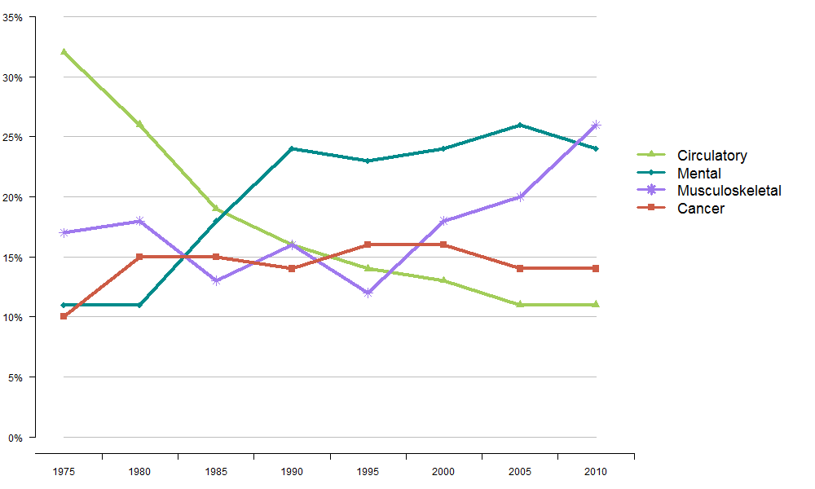
Skill Closure
Look at the graph below. Identify the mistakes in the graph and how they should be fixed.

Slide 17
Independent Practice
On graph paper, draw a scatter graph of the data below.
Aim: To find out if different metals heat up at different rates.
Steps for drawing a scatter graph:
Draw the horizontal and vertical axes.
Label the horizontal axis with the independent variable, including units.
Label the vertical axis with the dependent variable, including units.
Mark each data point with a small dot.
Draw a line of best fit through or near as many dots as possible.
Add a key if there is more than one set of data.
Write an appropriate title.
Time (min) | Tin Temperature (°C) | Copper Temperature (°C)
0 | 25 | 25
2 | 35 | 30
4 | 47 | 36
6 | 57 | 42
8 | 65 | 50
10 | 72 | 55

